Slide 1
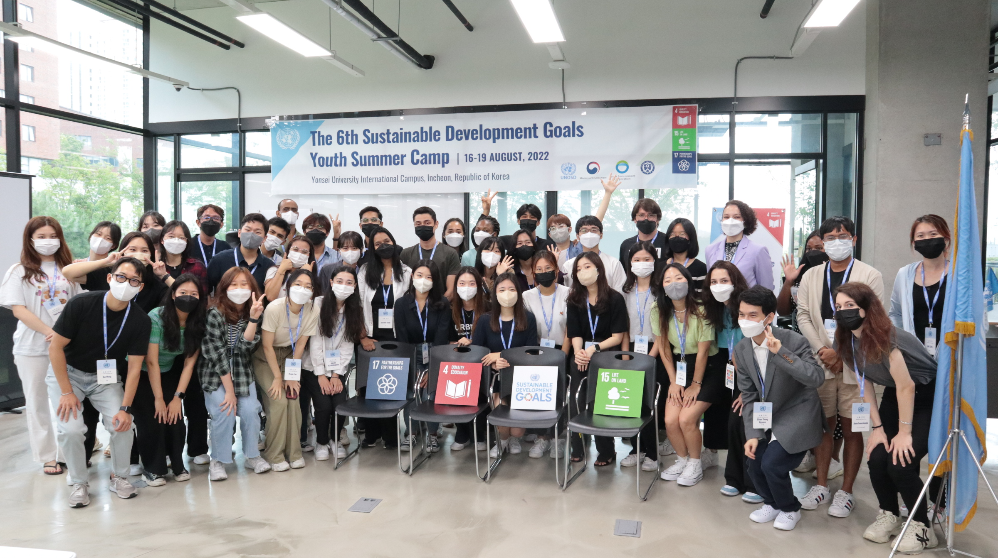
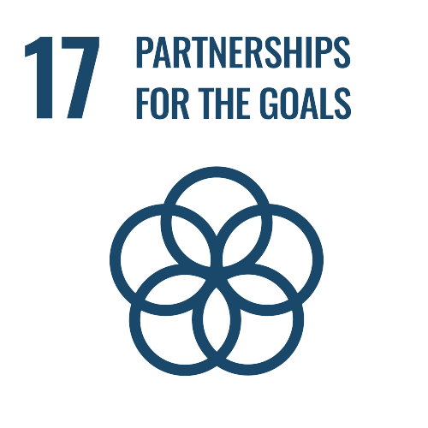
UNOSD 6th SDGs Youth Summer Camp
Tuesday, 16 August 2022 to Friday, 19 August 2022
Enhance participants’ knowledge of the 2030 Agenda through lectures and workshops
Design a product answering a need related to SDG 4 (Quality Education) or SDG 15 (Life on Land) in groups
Present the product to judges and other groups at the end of the Camp

Slide 2
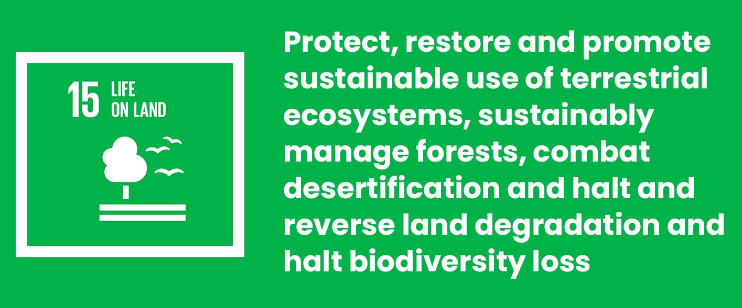
Creating awareness on Korea’s biodiversity
The public awareness on biodiversity in Korea is reported to reach 70% compared to 96% in France or 94% in China. (Biodiversity Barometer, 2013) → Need to bridge the awareness gap among the younger generations.
→ Engage citizens as early as possible to create inclination for sustainable responsibility and actions

Slide 3
Engaging younger generations on biodiversity topics
According to a report by the state-run Korea Information Society Development Institute, 95.9 percent of middle school students and 95.2 percent of high school students owned smartphones as of 2018.
→ Create an interactive and immersive solution using the theory of the gamification of education on sustainability

Slide 4
Our final product : The Oneul (오늘) Project
Phone application that will inform Korean students about the biodiversity surrounding them, the threats it is subject to as well as integrating habits leading to direct/indirect protection of these areas and species
Implemented through partnerships with Korean Middle Schools, possibly through making it part of the 자율학기제 (free semester) curriculum or by giving additional credit to participating students
Prototype
Action starts TODAY !

