Slide 1
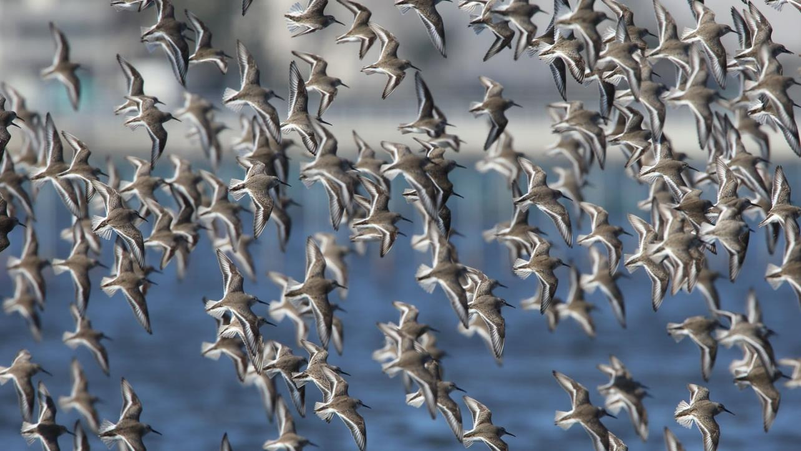
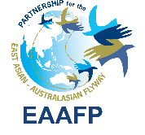
Sustaining wetland ecosystems and mechanisms to scale up ecosystem restoration
Doug Watkins Chief Executive, EAAFP Secretariat
Notes:
Thanks for the invitation for me to share about this topic: Biodiversity in Urban Areas.

Slide 2
How Wetlands Support Achievement of the SDGs
© Ramsar Secretariat

Slide 3
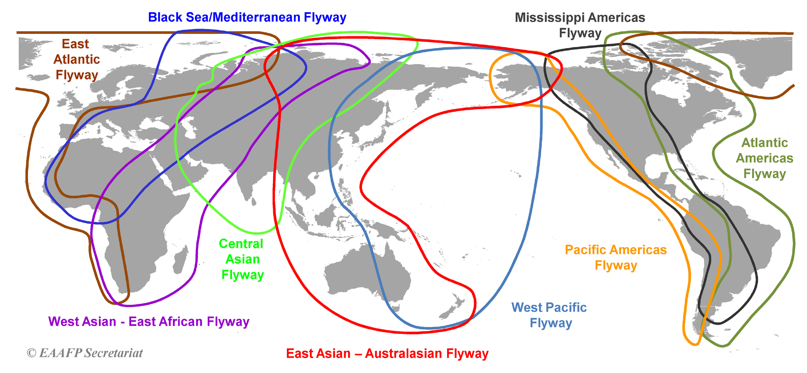
Migratory Waterbird Flyways of the World

Slide 4
East Asian-Australasian Flyway Partnership (EAAFP)
2002 – EAAFP adopted in the list of the World Summit on Sustainable Development as a Type II initiative
EAAFP is a network of partners within the East Asian-Australasian Flyway (EAAF)
Aims: Conserve migratory waterbirds, the wetlands they use and the ecosystem services they provide to the local community

Slide 5
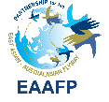
East Asian – Australasian Flyway Partnership (EAAFP)
The Partnership provides a flyway-wide framework to promote dialogue, cooperation and collaboration between a range of stakeholders at all levels to conserve migratory waterbirds and their habitats, and livelihood of local communities in the East Asian – Australasian Flyway (EAAF)
Notes:
We know that no single country or organization can save all the 50 millions waterbirds of 210 speices in EAA Flyway, we need to work together

Slide 6
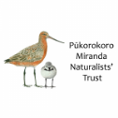
39 Partners of EAAFP
INTERGOVERNMNETAL ORGANISATIONS (6)
GOVERNMENT PARTNERS (18)
INTERNATIONAL NGOs (13)
INTERNATIONAL
ORGANISATION (1)
PRIVATE SECTOR (1)
Notes:
Partnership is unique, as it includes all sectors, government, NGO, private sectors
39 partners
Sitting on the same table, equally to discuss matters about conservation of migratory waterbirds and wetlands.

Slide 7
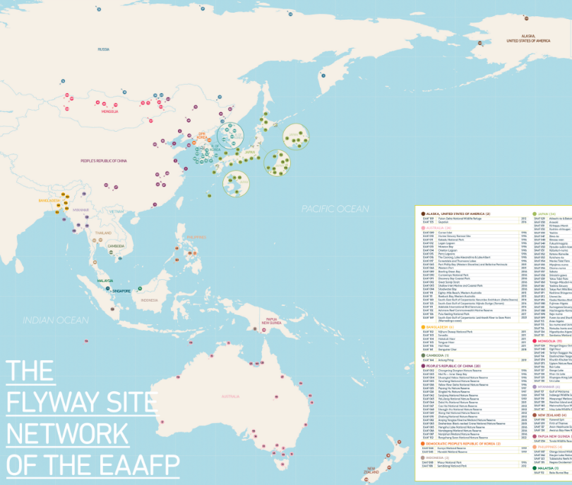
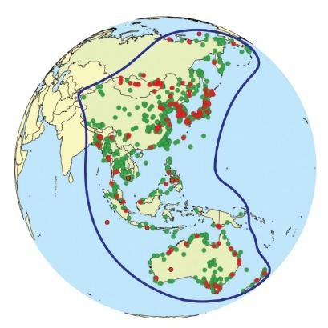
Flyway Network Sites: 152 from 19 countries
1000+ Important sites for migratory waterbirds
Aim: To ensure that wetlands are sustainably managed to support migratory waterbirds
Meeting criteria of a Ramsar Site
Designated by Government

Slide 8
Our objectives
DEVELOP
the Flyway Site Network of international importance for the conservation of migratory waterbirds
ENHANCE
Communication, Education and Participation and Awareness (CEPA) of the values of migratory waterbirds and their habitats
ENHANCE
Flyway research and monitoring activities, build knowledge and promote exchange of information on waterbirds and their habitats
BUILD
Habitat and waterbird management capacity of natural resource managers, decision makers and local stakeholders
DEVELOP
Flyway-wide approaches, especially for priority species and habitats, to enhance the conservation status of migratory waterbirds
© Lee Kisup

Slide 9
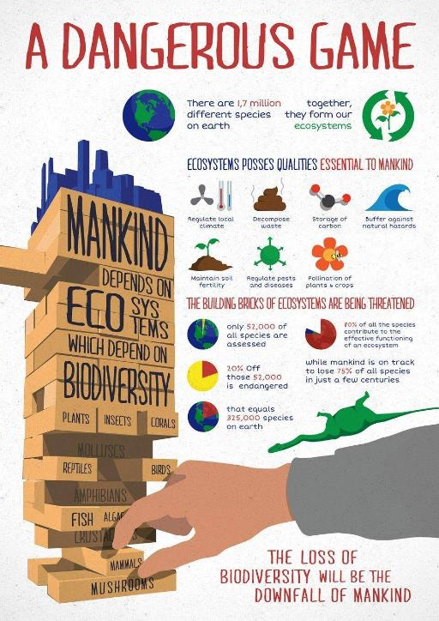
© TrashOut
Notes:
Biodviersity is supporting all mankind, with more biodiversity we have a more stable base, and the more secure we are. And knowing how the birds, frogs, insects, mammals are doing, through monitoring and surveys, is an indicator of how healthy the environment we are living in.
On the other hand, without them, we, human and our society will collapse.

Slide 10
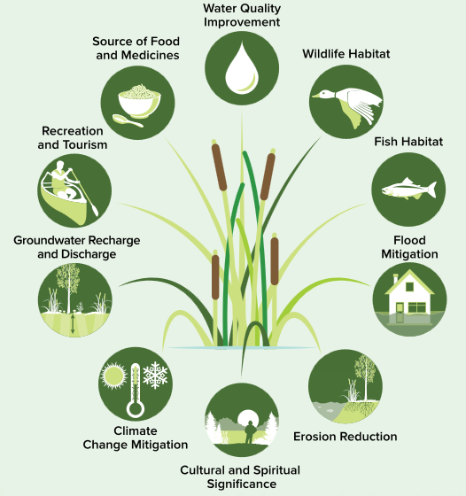
Ecosystem services and wetland loss
© World Wetlands Day 2022: https://www.un.org/en/observances/world-wetlands-day
Source: A Wetland Conservation Strategy for Ontario 2017–2030

Slide 11
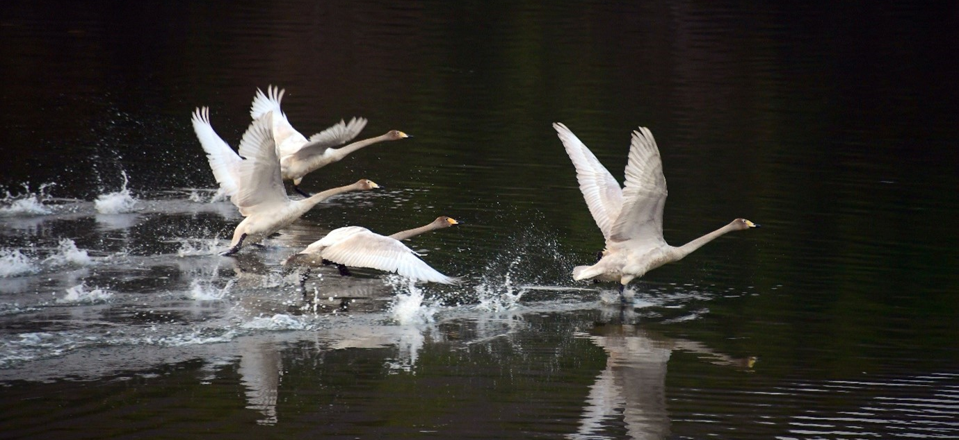
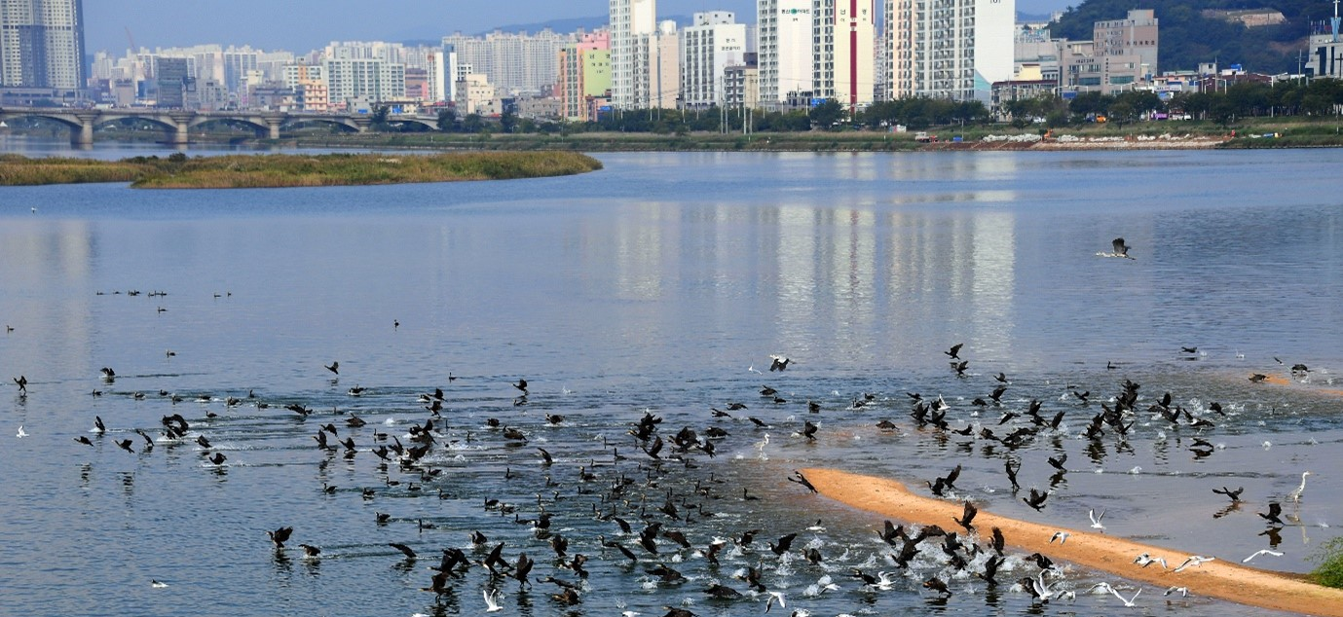
Example of Wetland Restoration
Flyway Network Site Ulsan Taehwa River in Republic of Korea
Late 90s, Ulsan City Government started to restore the river
Improve water quality
Remove concrete revetment and restore natural riverine ecosystem
Install eco-friendly structure such as fish ladders
Results
Clean water
Biodiversity increased
In 2012, was selected as one of South Korea’s twelve eco-tourism sites
© Ulsan Metropolitan City
© Ulsan Metropolitan City
Notes:
In the late 1990s, Ulsan City Government started to restore the river to improve water quality, river cleaning and secure water flow; restoring riverine ecosystem including remove concrete revetment, and restore natural habitats, installing eco-friendly structure such as fish ladders. Wildlife like migratory birds, mammals and fish (salmon) were recorded to return to the river. The river also provides recreational services for citizens.

Slide 12
Wetland Health - Takeaway Messages
Ongoing engagement of the local community is essential for success.
Develop mechanisms for this engagement and its linking to Local, Regional and National Government.
Focus on Restoring Wetland Health.
Develop a strong science program to inform “adaptive management approaches”.
Develop a local awareness program to inform and engage the local community.
Celebrate your successes!

Slide 13
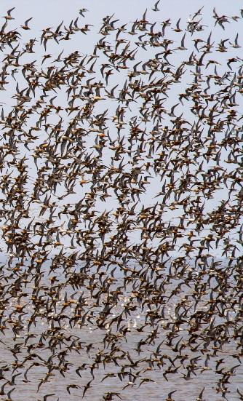
The Regional Flyway Initiative
RFI Long-term Vision and Delivery Timeframe
GOAL
Will deliver 50+ flyway sites under Protection / Sustainable Management providing a coherent network of priority sites with favorable conservation status with species numbers maintained or enhanced on the EAAF.
Partnership
Delivery Timeframe
Development Stage Delivery
Stakeholder Group
ADB,
EAAFP,
BirdLife International (BLI)
Comprising of 2 stages:
i) DEVELOPMENT STAGE Grant finance
2022 – 2023 (2yrs)
$1 million secured
ii) INVESTMENT STAGE
Loan / Grant Blend
2023 onwards (10+yrs) $3 billion target
Implemented by consortium led by BLI with an international team including EAAFP, Wetlands International, Paulson Institute, NUS, & others
Established including WWF, UNEP, ICF, IUCN, WI, USAID, AFD amongst others.
REGIONAL FLYWAY INITIATIVE Building a Business Case for Sustainable Wetlands

