Slide 1
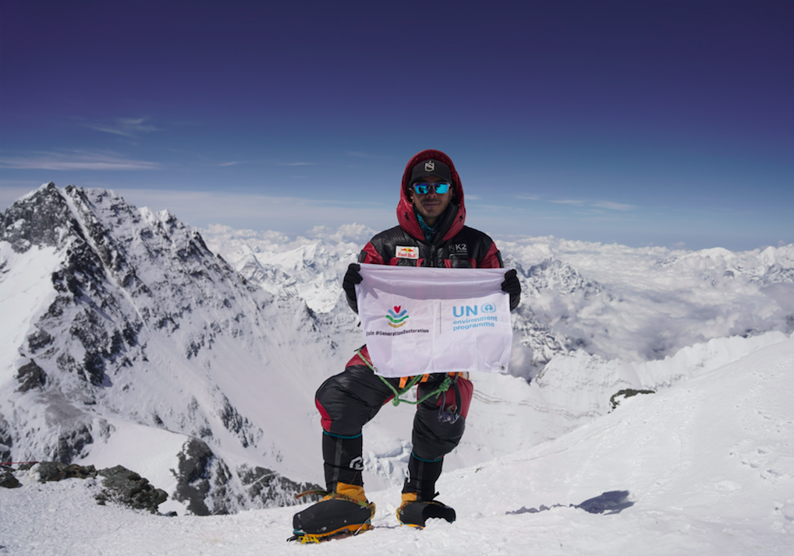



UNITED NATIONS DECADE ON
ECOSYSTEM RESTORATION
Science – Movement - Action
Notes:
Nepali mountaineer Nimsdai Purja embarks on a seemingly impossible quest to summit all 14 of the world’s 8,000-meter peaks in seven months.

Slide 2

OVERVIEW
2021: Building the Movement
2022: Calling for Action
2023: Empowering a new generation
2024: Focus on results (TBD)*
2025: Celebration and renewed resolve (TBD)*
*aligned with scheduled report to General Assembly

Slide 3

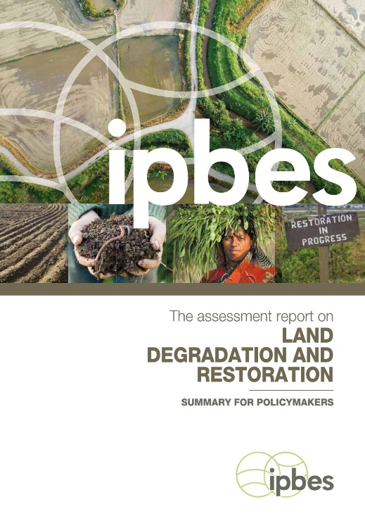
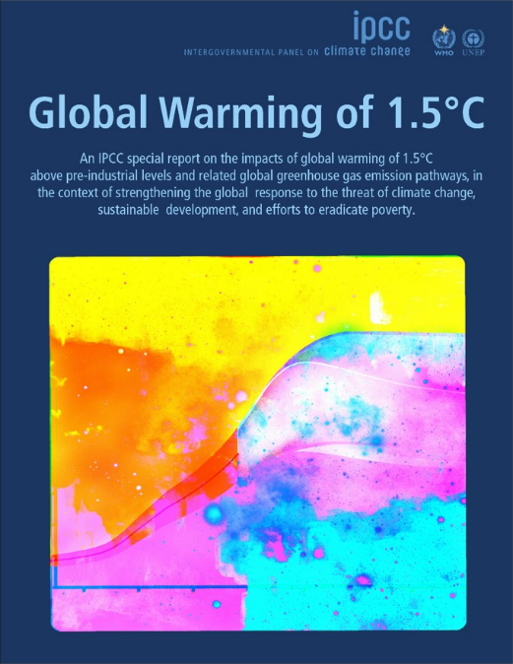
2021: LAUNCHING #GENERATIONRESTORATION
The Science Basis:
Only ten more years to avoid catastrophic climate change and biodiversity loss (IPCC, IPBES)
75% of Earth’s lands, 66% of oceans severely impacted by human activity (IPBES)
40% of world population suffering effects of soil degradation (IPBES); 1.5°C (or even 2°C) goal no longer attainable without boosting carbon sinks (IPCC)
UN Decade on Ecosystem Restoration timeline not a coincidence – but an idea whose time has come
Notes:
The UN Decade aims at upscaling and replicating restoration efforts for which it has defined ten principles for ecosystem restoration (Next slide)

Slide 4

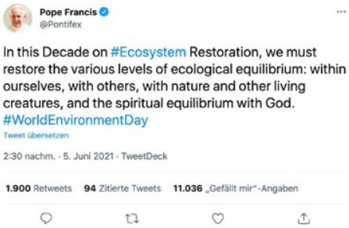
2021: LAUNCHING #GENERATIONRESTORATION
Public launch with World Environment Day 2021 – Reimagine. Recreate. Restore.
Significant political and private sector commitments to restoration
Snap Challenge engages millions on social media around restoration practices
More than 42,000 media articles on Decade Launch and World Environment Day – 17% increase to previous campaign
Notes:
The UN Decade aims at upscaling and replicating restoration efforts for which it has defined ten principles for ecosystem restoration (Next slide)

Slide 5

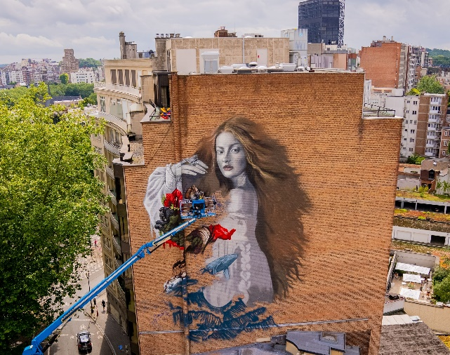

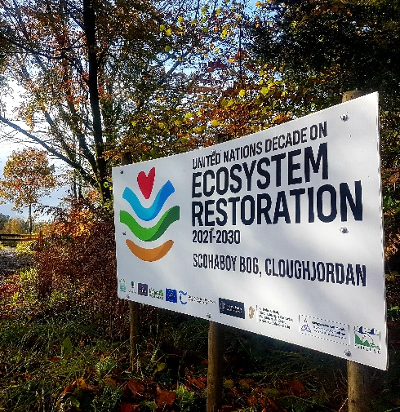
2021: LAUNCHING #GENERATIONRESTORATION
More than 150 partners – from UN Agencies to ecopreneurs and restoration implementers – have joined UN Decade; combined reach of at least 600 Million
Outreach through culture, arts and science; Film Festivals; University challenge with over 1,000 universities; streetart collective pledges 50 restoration murals across the globe. More examples on www.decadeonrestoration.org
UN Decade Advisory Board brings together leading thinkers, artists, educators, indigenous rights activists, film-makers and many more for restoration
Notes:
The UN Decade aims at upscaling and replicating restoration efforts for which it has defined ten principles for ecosystem restoration (Next slide)

Slide 6

2021: LAUNCHING #GENERATIONRESTORATION
PUTTING ECOSYSTEM RESTORATION ON THE GLOBAL AGENDA
Twitter’s marketing analysis, based on billions of tweets and conversations, identifies “The Great Restoration” as one of three trends too big to miss in 2022
Notes:
The UN Decade aims at upscaling and replicating restoration efforts for which it has defined ten principles for ecosystem restoration (Next slide)

Slide 7

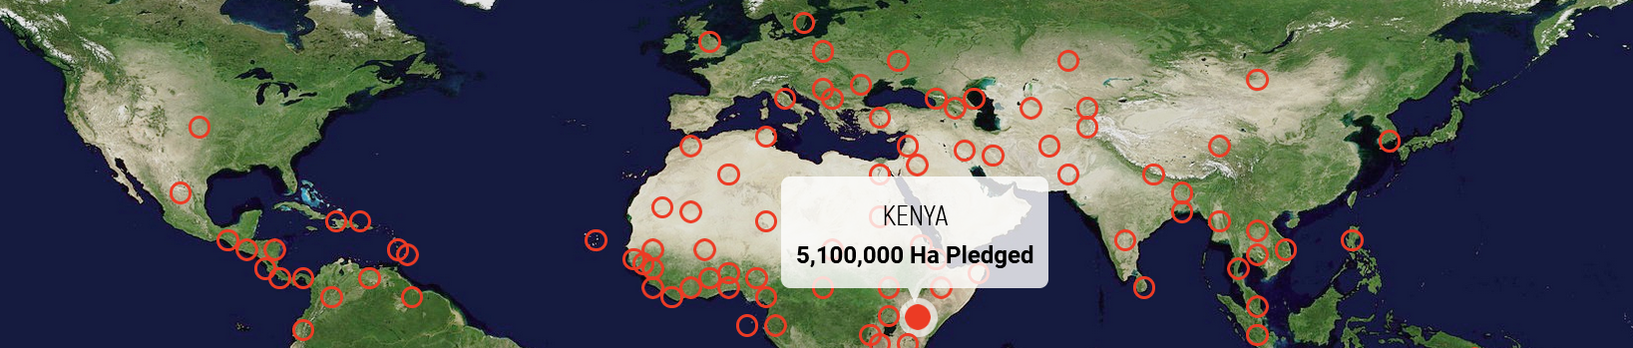
2022: FROM COMMITMENTS TO ACTION
The Science Basis:
Countries have already pledged to restore more than 1 billion hectares – an area larger than China – as part of their commitments to Sustainable Development Goals and Rio Conventions
(UNEP / FAO: Becoming Generation Restoration Report)
BUT…
little is known about quality of restoration and progress towards goals
citizens are mostly unaware of pledges to action within their countries and globally
restoration success stories and lessons learned not communicated widely
= Not enough action on the ground

Slide 8
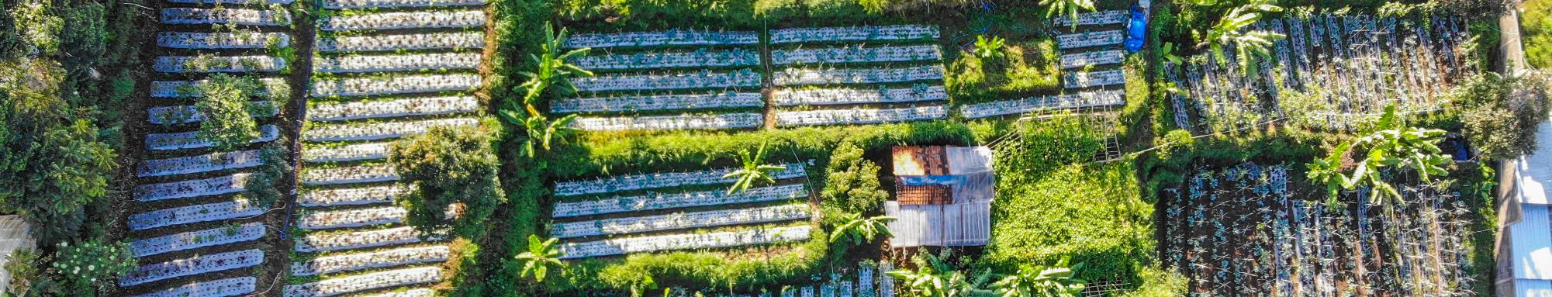
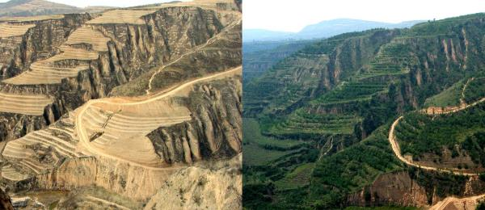
2022: FROM COMMITMENTS TO ACTION
PUTTING A FACE TO THE PROMISE OF RESTORATION
Ecosystem Restoration is possible and desirable
Yet, without concrete, widely publicized examples, it stays abstract and hard to grasp
Before and after images of restoration at the Loess Plateu, where 4 million hectares of land have been restored and incomes of farmers have doubled

Slide 9
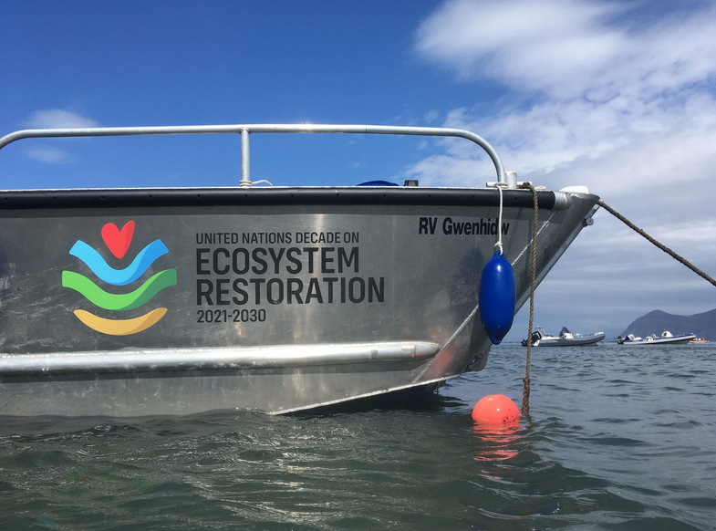
2022: FROM COMMITMENTS TO ACTION
FOR MORE ACTION:
OFFICIAL WORLD RESTORATION FLAGSHIPS
“UN Decade Flagships are the first, best, or most promising example of ecosystem restoration, adding value and embodying the 10 Restoration Principles, and inspiring others to undertake or accelerate restoration at significant scale”
Strategy for the UN Decade on Ecosystem Restoration
Jake Davies, Project Seagrass, UN Decade Supporting Partner

Slide 10
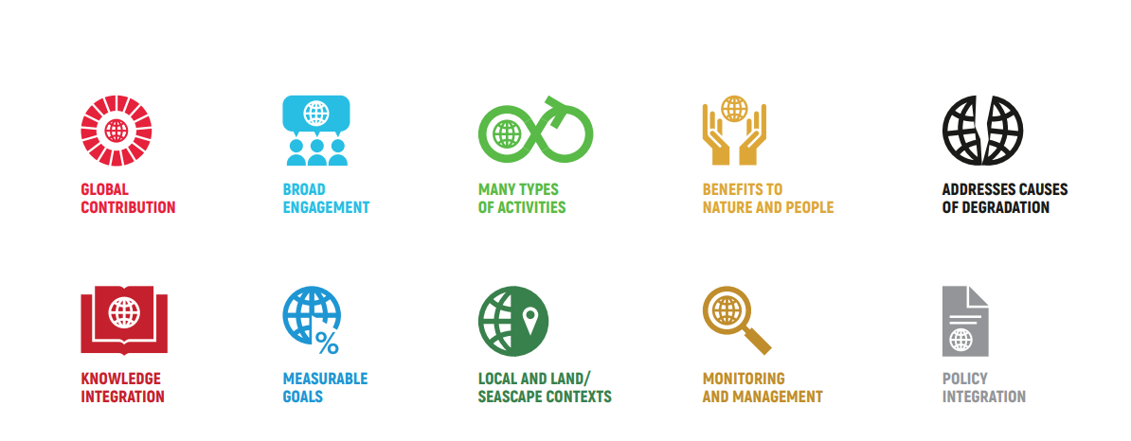
TEN PRINCIPLES THAT UNDERPIN ECOSYSTEM RESTROATION
Jake Davies, Project Seagrass, UN Decade Supporting Partner

Slide 11


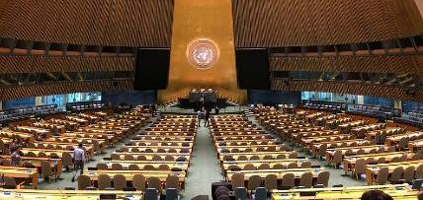
TIMELINE FOR SELECTION OF FIRST TEN FLAGSHIPS
NOVEMBER 2021
Consultation and mobilization of UN Decade partner on flagships
JANUARY 2022
Invitation by UNEP and FAO sent to Member States
MARCH 2022
Open call for flagship nominations accompanied by global campaign
APRIL – OCTOBER 2022
Assessment of the results, in-country development of campaign materials, media and outreach plan
DECEMBER 2022
Announcement of first 10 flagships @ UN CBD COP15
THROUGHOUT 2022
Global and national/regional campaigns to boost “Leaders of Restoration” and garner support for official flagships
Notes:
(Next slide)

Slide 12

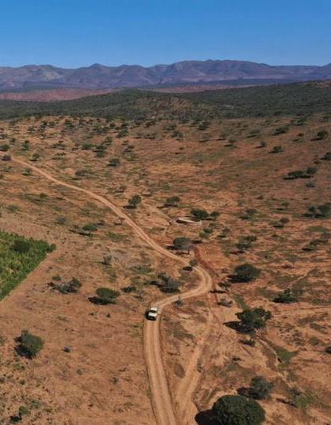
2022: A MULTI-PARTNER TRUST FUND FOR THE UN DECADE
MPTF is up and operational, currently being supported by Germany, other donors are coming on board as well.
Outcome 1:
A global movement on ecosystem restoration established that catalyzes restoration
initiatives, political will, exchange of knowledge, and cross-sectoral collaboration – with a focus on support for and within flagship countries and regions
Outcome 2:
Increased capacity and capability in private, public sector and civil society for policy reform, to catalyze investments and to access resources are resulting in restoration actions on the ground and implementation within Flagship programmes
Outcome 3:
Results documented and shared, through monitoring and reporting of biophysical and socio-economic elements of sustainable ecosystem restoration and influencing activities for ecosystem restoration
Notes:
The UN Decade aims at upscaling and replicating restoration efforts for which it has defined ten principles for ecosystem restoration (Next slide)

Slide 13

2023: EMPOWERING A NEW GENERATION
The Science Basis:
Upcoming Spotlight Report “Employed by Nature” (working title), focusing on restoration and job creation
Focus on prospects for young people, skills in a restoration economy
Co-authored by UNEP and ILO
Planned release: October / November 2022 (around UNFCCC COP27)
Notes:
The UN Decade aims at upscaling and replicating restoration efforts for which it has defined ten principles for ecosystem restoration (Next slide)

Slide 14
2023: EMPOWERING A NEW GENERATION
Campaign:
Call for Young Champions of the Earth launched, aligned with report findings and relevant messaging
Young Champions campaign built out to restoration incubator, with donor-support to include:
  Capacity building (incubator)
  Campaigning support
  In-country support through UN Decade Partner
  In-country youth campaigns targeting formal and informal education, co-led by Young Champs and UN Decade Partner / UNEP, to scale ideas and empower 10,000+ young people
Notes:
The UN Decade aims at upscaling and replicating restoration efforts for which it has defined ten principles for ecosystem restoration (Next slide

Slide 15
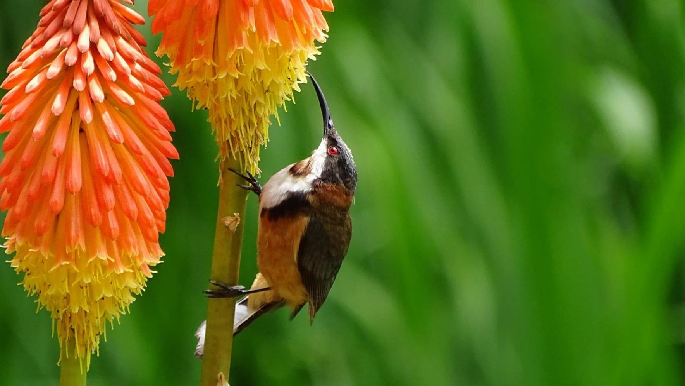
JOIN #GENERATIONRESTORATION
THANK YOU

