Slide 1



ESCAP Capacity Development Tools to Support Implementation of Paris Agreement
CPI Modelling and Simulation Tool
Aneta Nikolova, Environment Affairs Officer, Environment and Development Division, ESCAP
nikolova@un.org
Dr. Poonperm Vardhanabindu, Climate Modeller and Analyst, ESCAP poonperm.ai.v@gmail.com
The 5th Greenhouse Gas Inventory System Training Workshop , 13-15 February 2023, UNCC, Bangkok, Thailand

Slide 2

Used to assess the impact of carbon pricing policy instruments on key macroeconomic, social and environmental indicators
Built as an extension of the ESCAP Macroeconomic Model
Allows flexibility to experiment with how carbon revenue is spent
Develops scenarios that are conditional on a country’s climate policy ambition and enabling factors to support climate policy
How can carbon pricing contribute to C19 recovery? https://www.unescap.org/blog/how-can-carbon-pricing-contribute-post-covid-19-recovery
UNESCAP’s Carbon Pricing Policy Simulation Tool

Slide 3
The ESCAP Macroeconomic Model
A complete global model:
46 individual full country models for the Asia and Pacific region
Smaller models of 9 key trading partners and 4 major regions
Models are linked together via trade, remittances, financial and energy markets
Founded on a standard macroeconomic framework, with additional channels to capture interactions with key social and environmental channels.

Slide 4
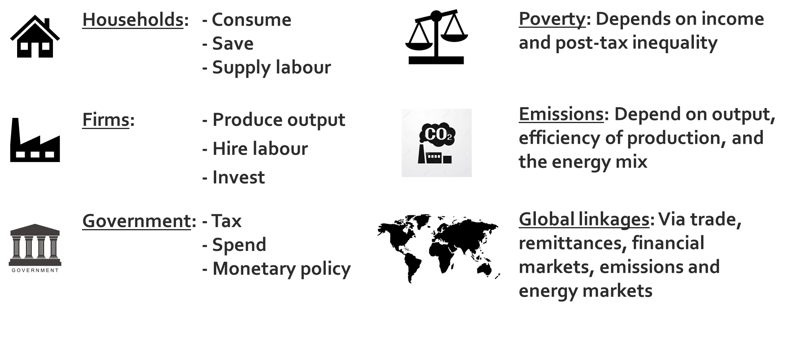
Key actors and features of the model

Slide 5
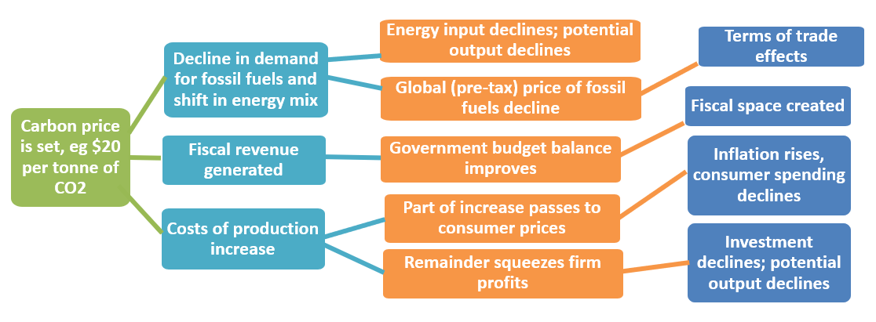
Modelling the transmission of a carbon price

Slide 6
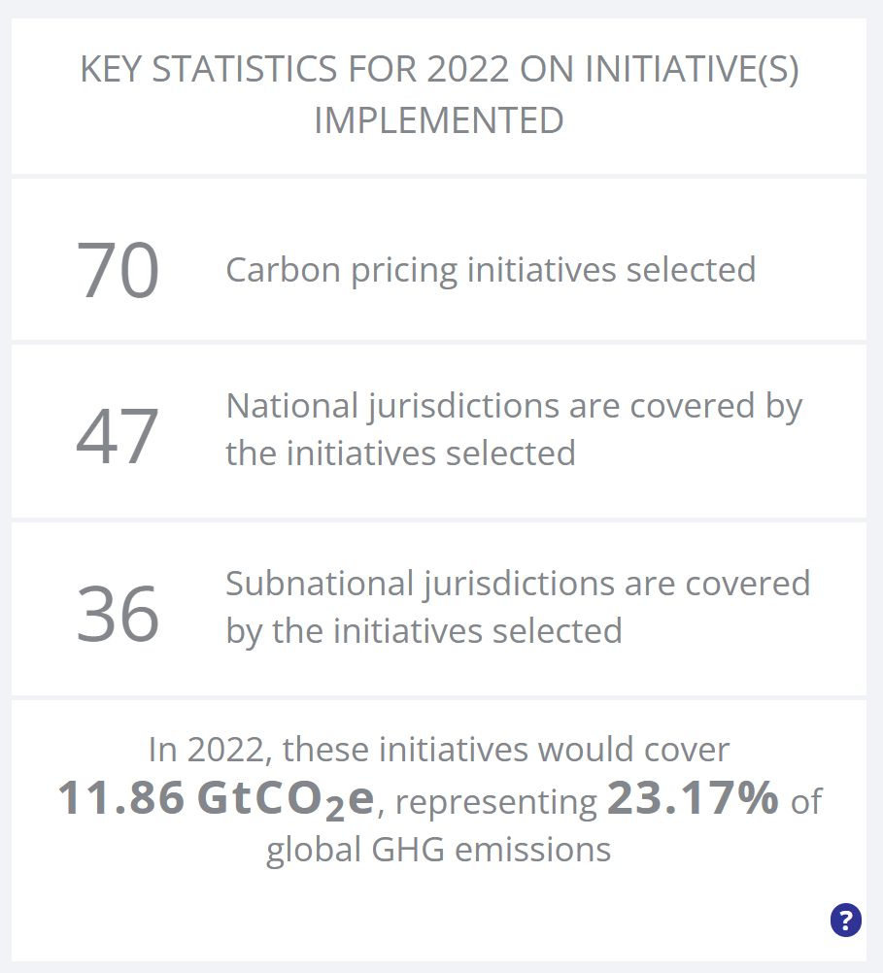
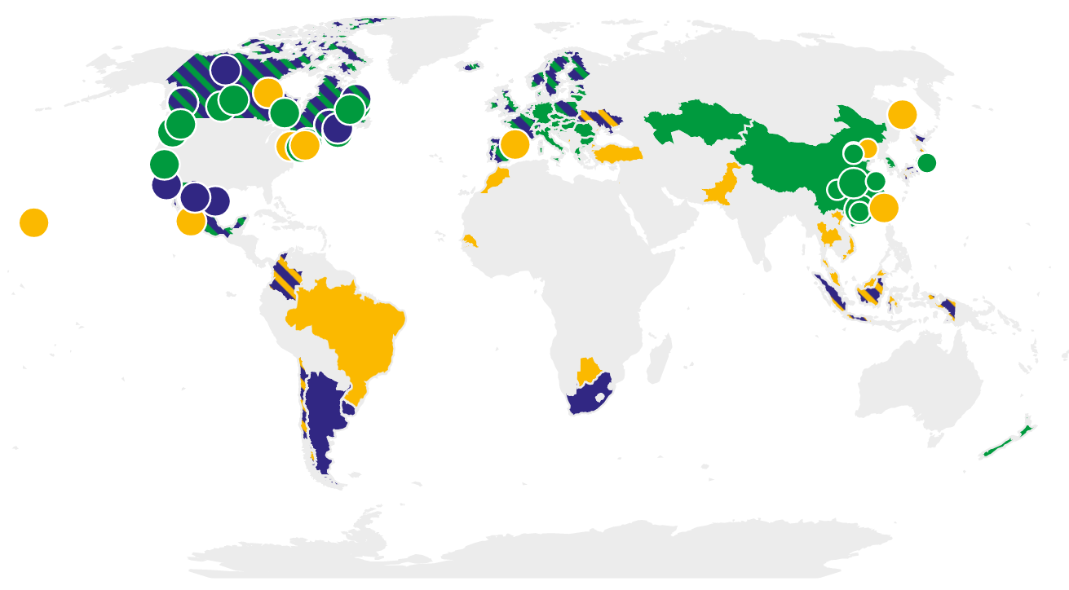

Carbon Pricing Adoption

Slide 7
Member Countries
New Zealand ETS | 2008
Tokyo CaT | 2010
Saitama ETS | 2011
Japan carbon tax | 2012
Beijing pilot ETS | 2013
Guangdong pilot ETS | 2013
Kazakhstan ETS | 2013
Shanghai pilot ETS | 2013
Shenzhen pilot ETS | 2013
Tianjin pilot ETS | 2013
Chongqing pilot ETS | 2014
Hubei pilot ETS | 2014
Korea ETS | 2015
Fujian pilot ETS | 2016
Singapore carbon tax | 2019
Indonesia carbon tax | 2022
Brunei Darussalam undecided | TBC
Indonesia ETS | TBC
Japan ETS | TBC
Malaysia ETS | TBC
Pakistan ETS | TBC
Shenyang ETS | TBC
Taiwan ETS | TBC
Thailand ETS | TBC
Turkey ETS | TBC
Vietnam ETS | TBC
Adopted and to adopt
Carbon Pricing

Slide 8



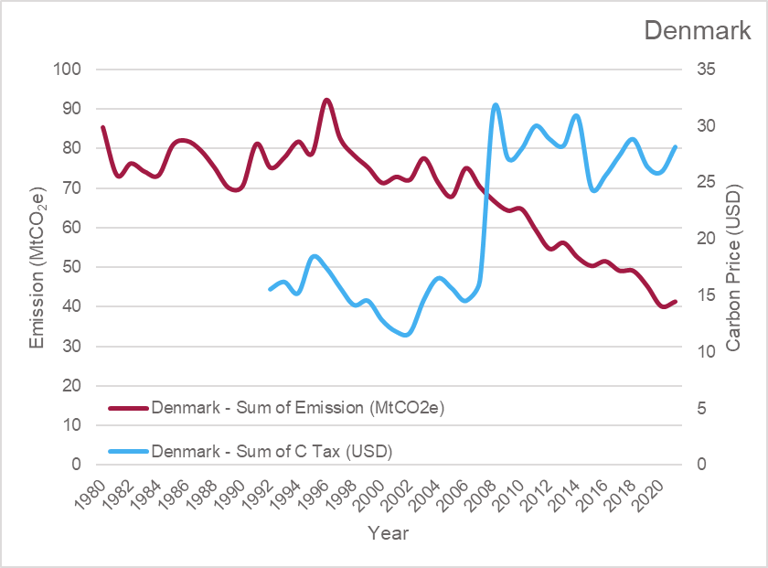
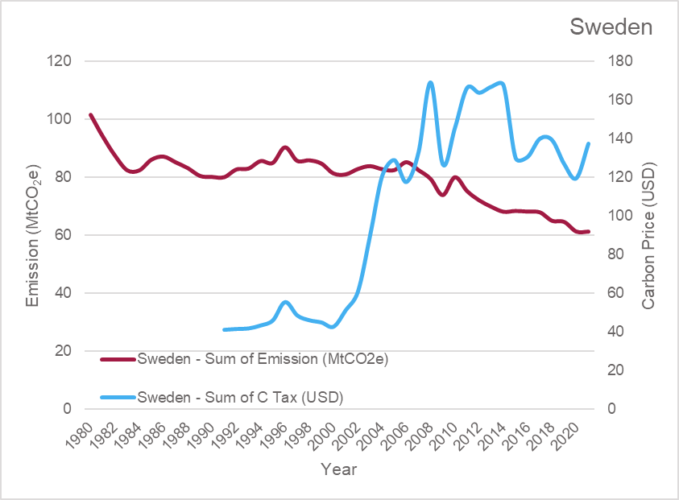
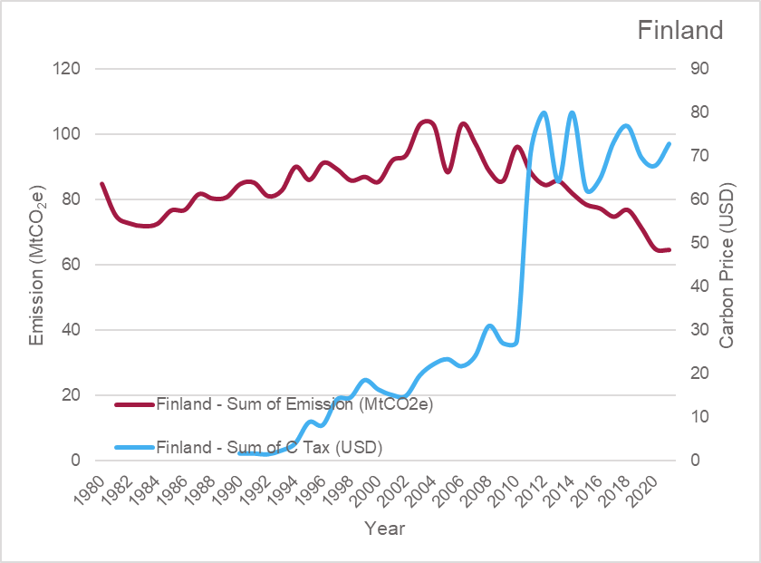



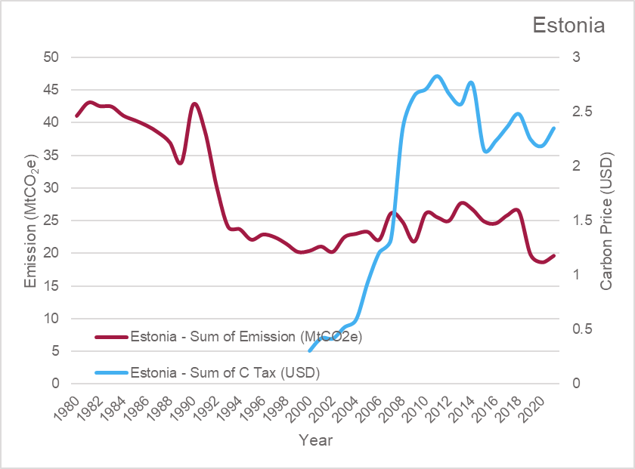
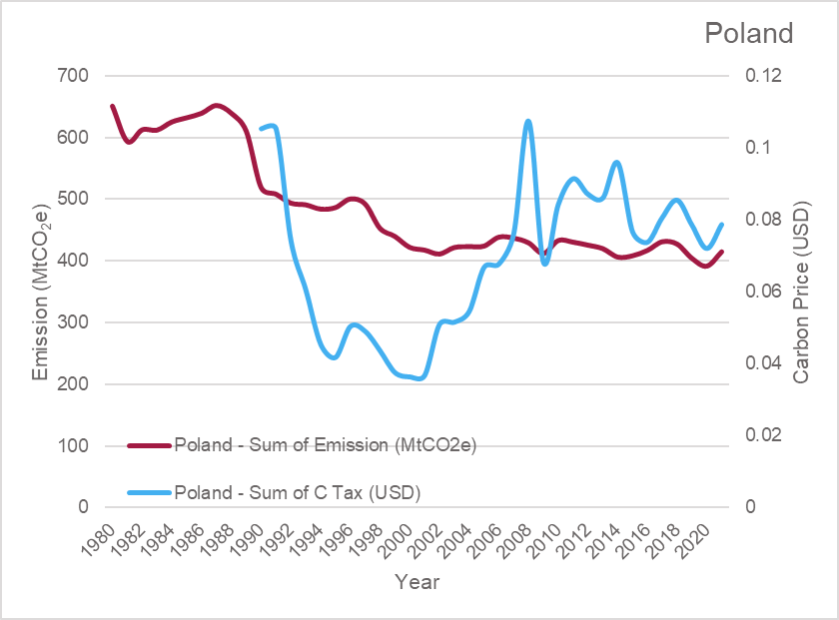
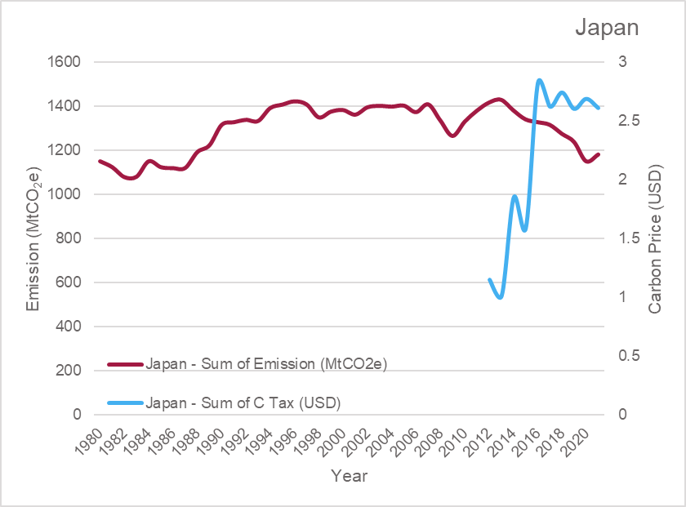
The influence from carbon pricing to emission

Slide 9
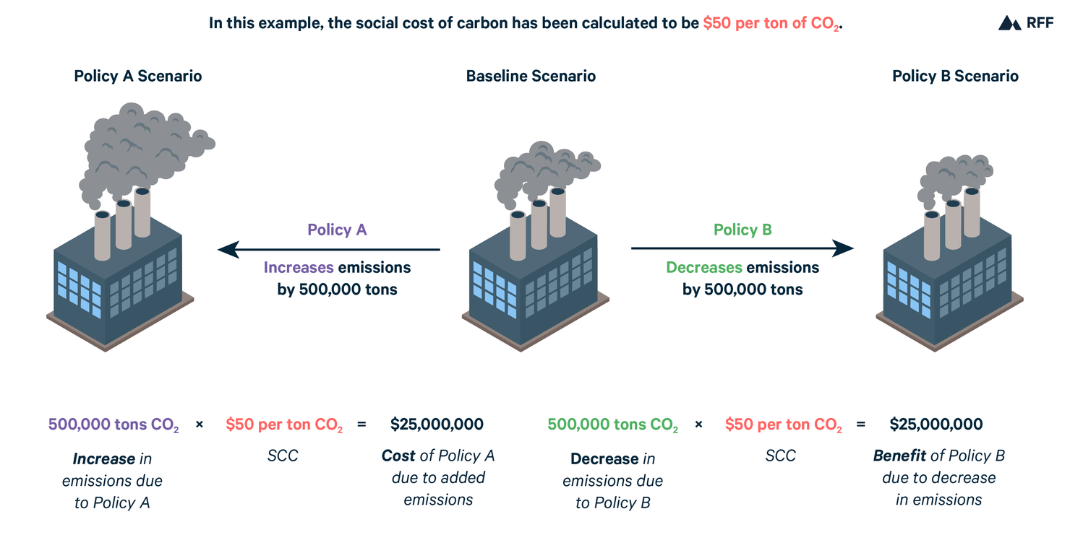
Carbon Price = Social Cost of Carbon
Pain Point
Many states do not have enough data to calculate the social cost of carbon

Slide 10
Carbon revenue generates fiscal space…
Revenue can be channeled back into the economy. The fiscal options include:
Spending on social protection. (Increases incomes, reduces inequality and poverty.)
Spending on environmental protection. (Builds resilience against climate change, reduces pollution, reduces CO₂ emissions)
Spending on health. (Raises labour productivity and potential output)
Spending on energy efficiency gains. (Reduces energy consumption, raises renewable share of energy, reduces pollution)
Spending on education. (Reduces inequality, raises labour productivity)
Spending on connectivity. (Improves financial inclusion, raises labour productivity)

Slide 11
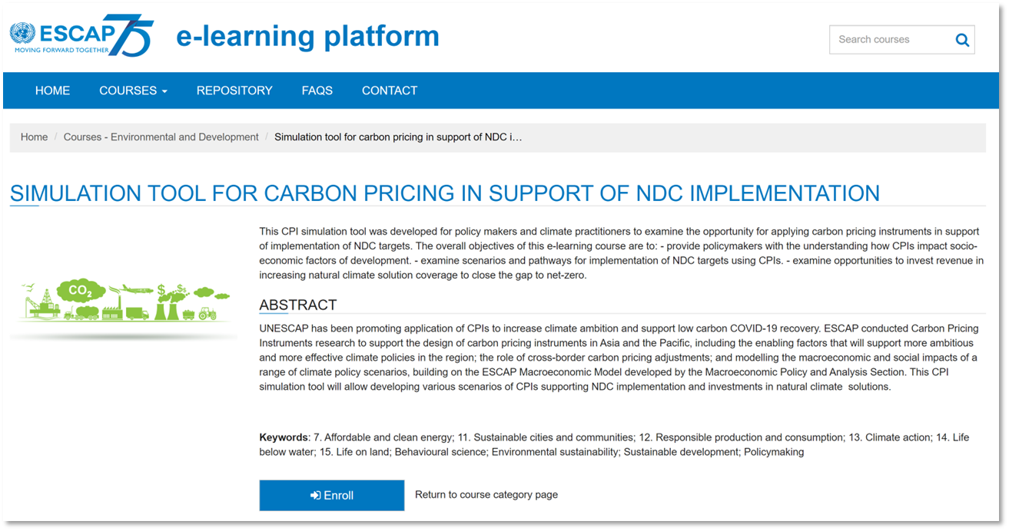

Next generation simulation tool:
CPIs to support NDC Implementation
https://e-learning.unescap.org/thematicarea/detail?id=56
shorturl.at/ceSY8
Notes:
Future features:
Preposition carbon price of custom reduction targets.
Sectorial emission and scenario if emission is to be reduced.
Improved UX/UI

Slide 12
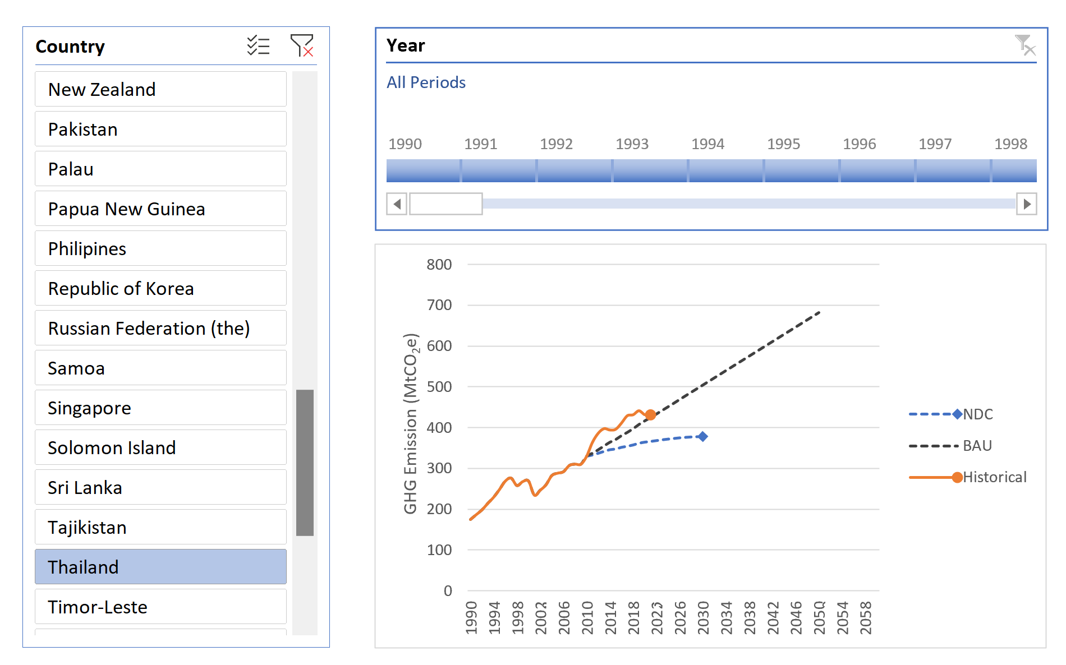
Emission Overview
Visualises the GHG emission of member countries in MtCO₂e. GHG information includes:
Historical emissions of member countries
Business-as-usual projection from 2010
Nationally Determined Contribution (NDC) scenario

Slide 13
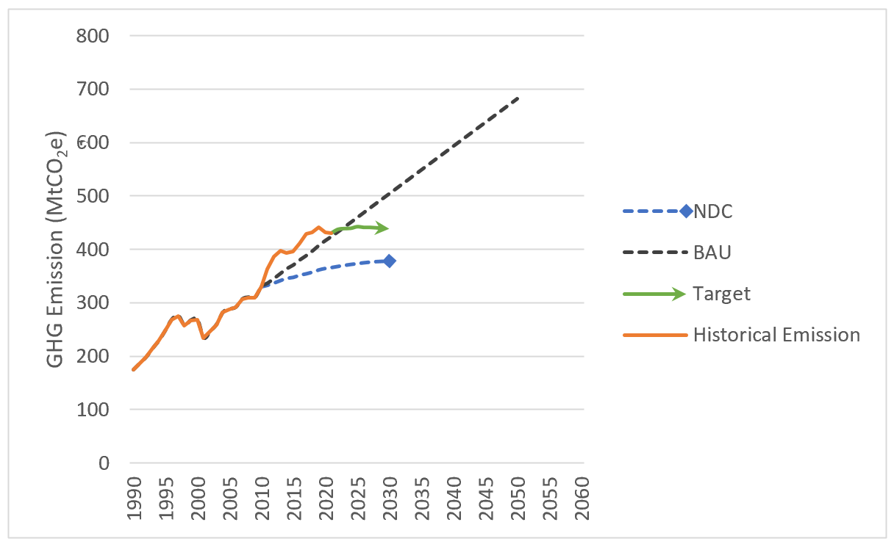
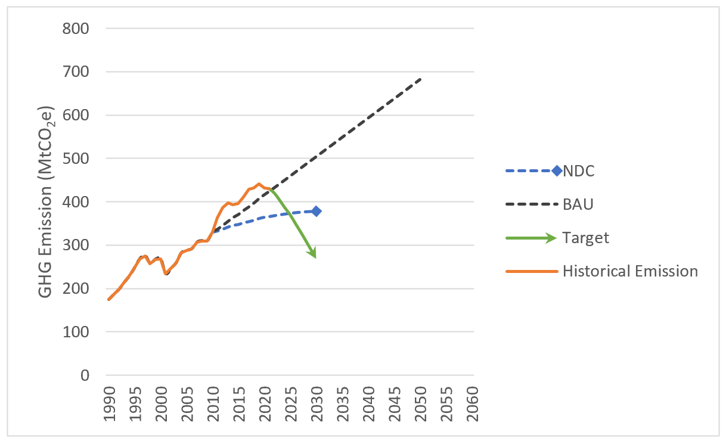
Target Setting
Set a reduction target (in percentage) from BAU and see the scenario of emission changes
10% Reduction
45% Reduction

Slide 14
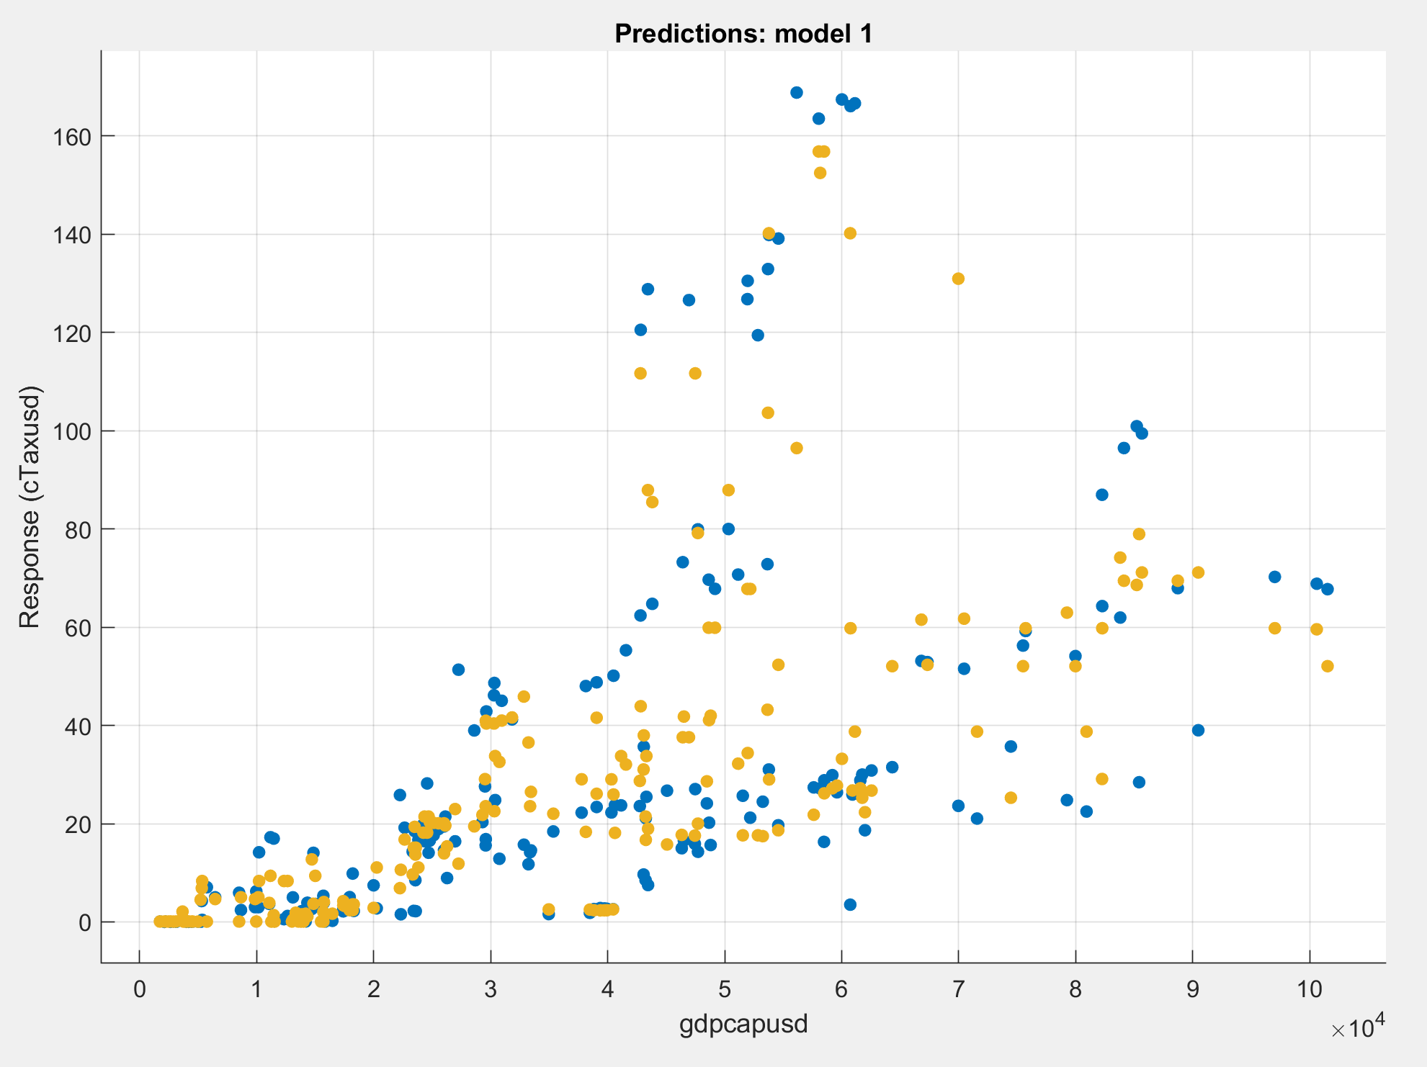
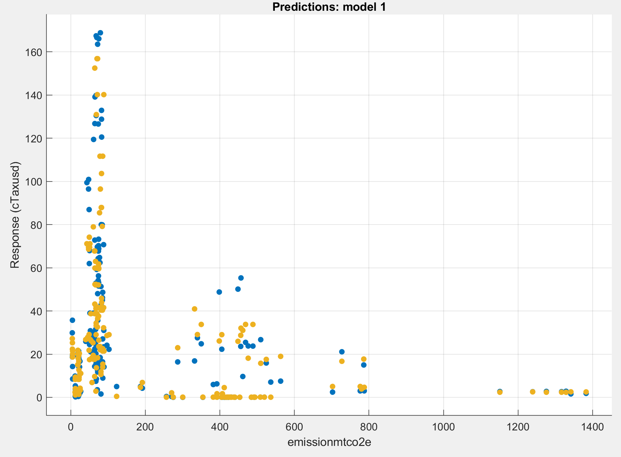
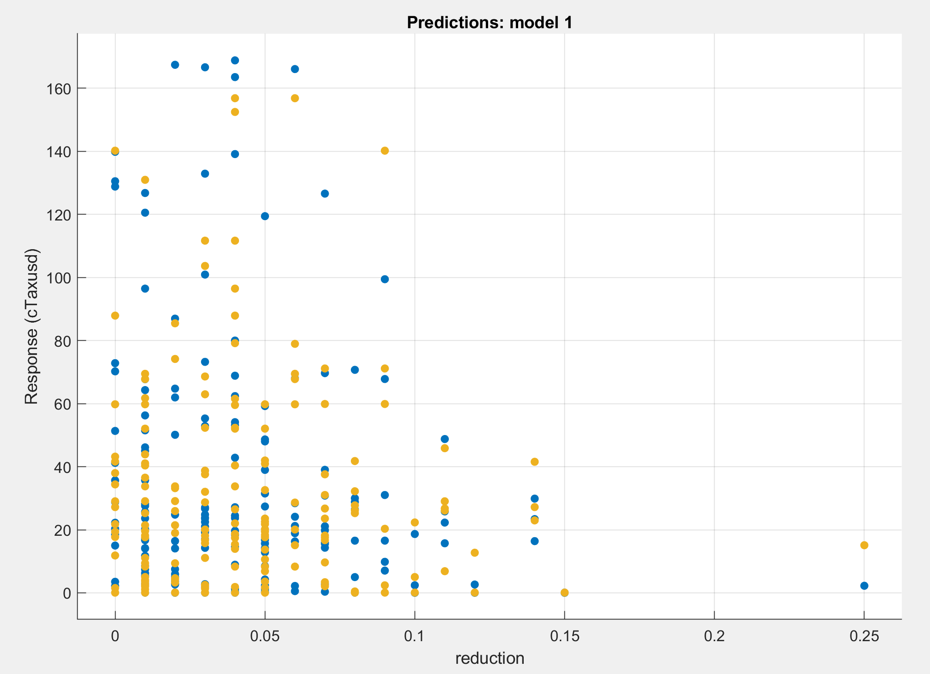
Developed from Artificial Intelligence
Not every country have adequate data to calculate the SCC.
This tool models the carbon price from success cases around the world

Slide 15
Carbon Price Model
In this version, the Carbon Price is calculated from the Social Cost of Carbon (SCC) modelled from Emission/GDP and global success cases. The Carbon Price Instrument in the current version is based on the price to have an impact to reach the Nationally Determined Contribution targets.
In the next version, users can see the preposition carbon price to achieve custom target reduction set in the previous section.

Slide 16
Future features:
Sectorial emission and scenario if emission is to be reduced.
Improved UX/UI

Slide 17
Thank you
Carbon Pricing Instrument (Beta) e-Learning
https://e-learning.unescap.org/thematicarea/detail?id=56
Link to the CPI
https://drive.google.com/drive/folders/1_PUlBhlKUZk-_XfNTkXZaMD_CHGH8SAe?usp=sharing

