Slide 1
Ecosystem Restoration
Benjamin Singer
Senior Forest and Land Use Specialist, Green Climate Fund
IUCN Leaders’ Forum, Jeju – 14 October 2022

Slide 2
Ecosystem Restoration and Climate Change
 | Climate Change
 | Mitigation | Adaptation | Co-benefits
Ecosystem restoration | Enhanced carbon sequestration and storage (green and blue carbon, above and below ground) | Increased resilience of: Ecosystems Communities Economies | Enhanced biodiversity Enhanced livelihoods Reduced poverty Increased income & revenue

Slide 3
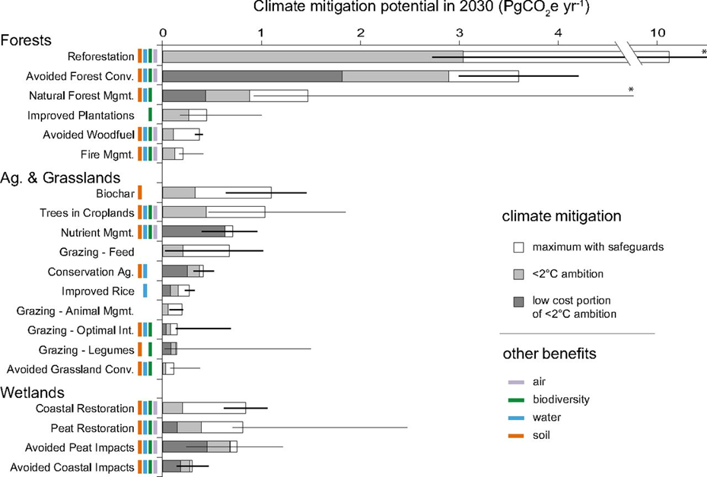
Source: Griscom et al. (2017). Natural climate solutions. PNAS 114 (44) 11645-11650.

Slide 4
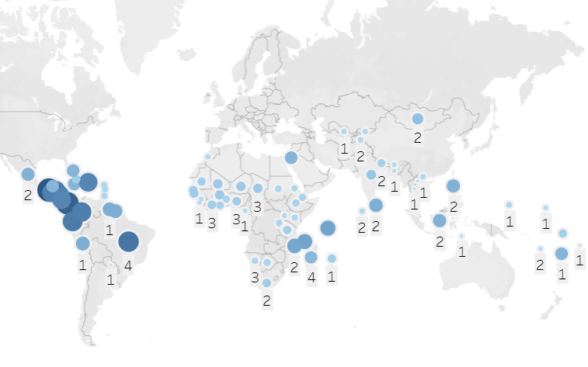
Status of GCF portfolio in Ecosystems
78 projects with Ecosystems Result Area (32 Africa, 22 LAC, 24 Asia-Pacific)
GCF approved funding: USD 1.16 billion
Financial Instrument: Predominantly grants.
Mangroves; coral reefs – coastal protection
Upland forests – watershed / erosion / landslide
Wetlands – floods
Aug 2022, up to B.33

Slide 5
Ecosystem Services enhanced through GCF projects

Slide 6
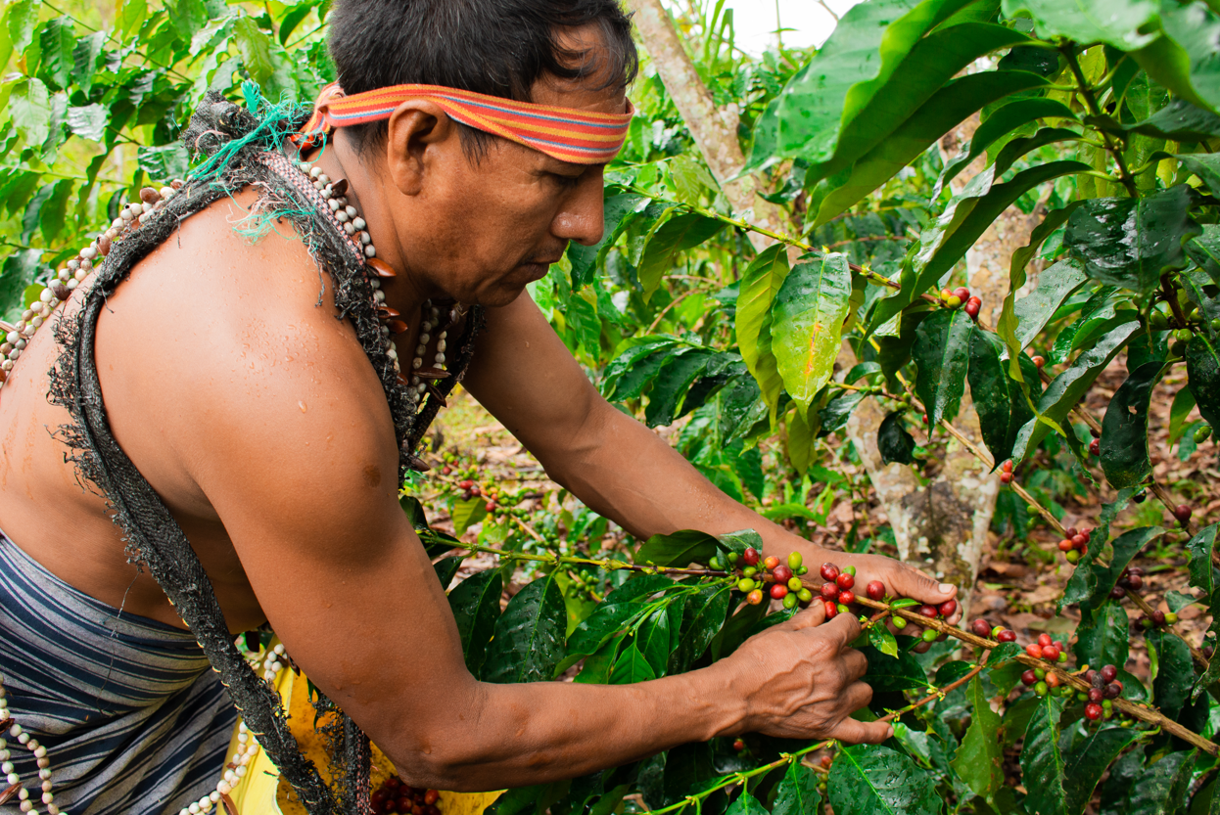
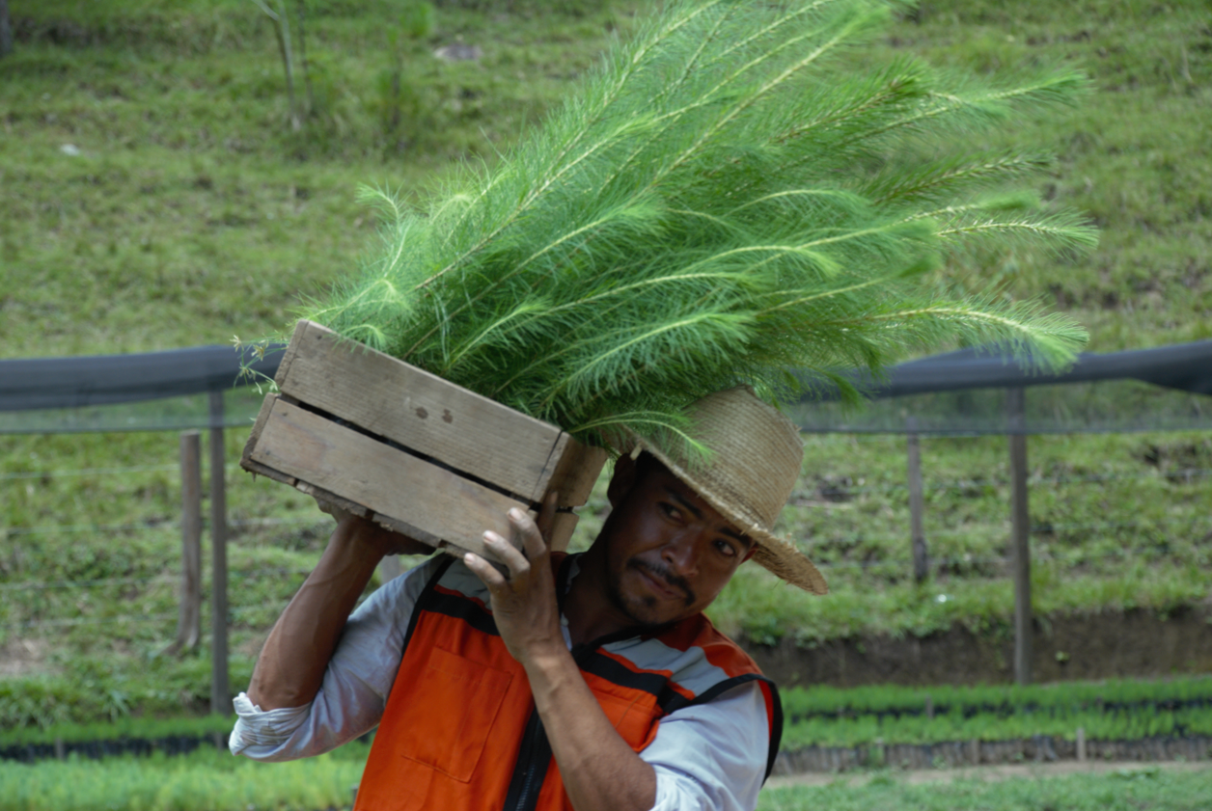
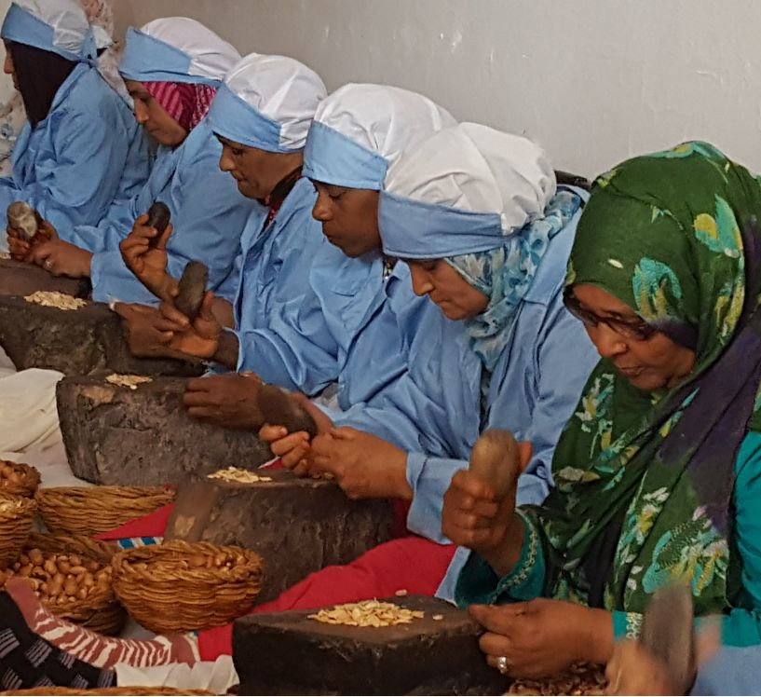
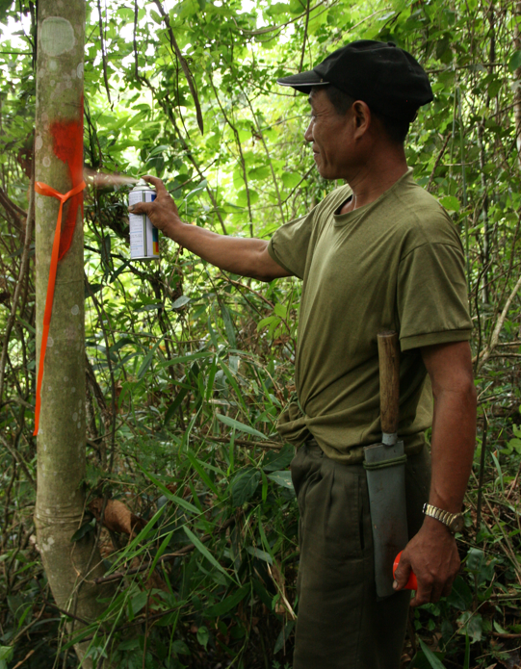
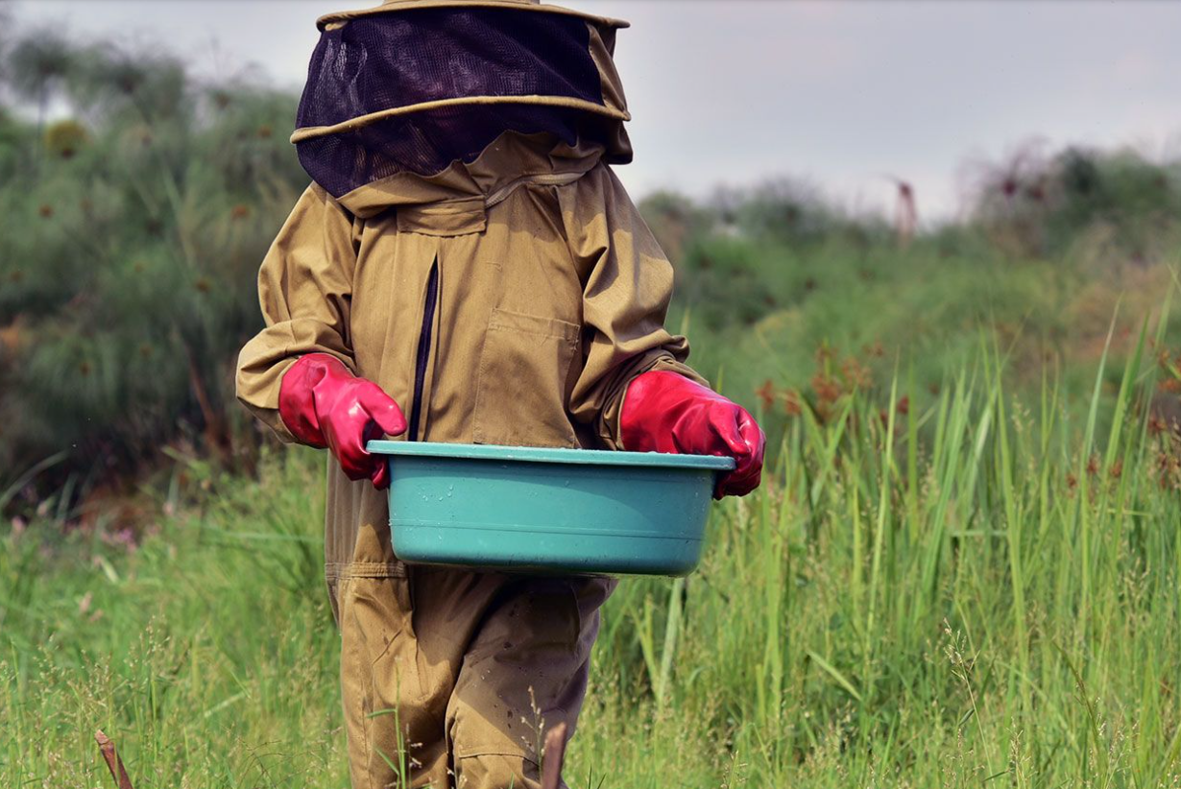
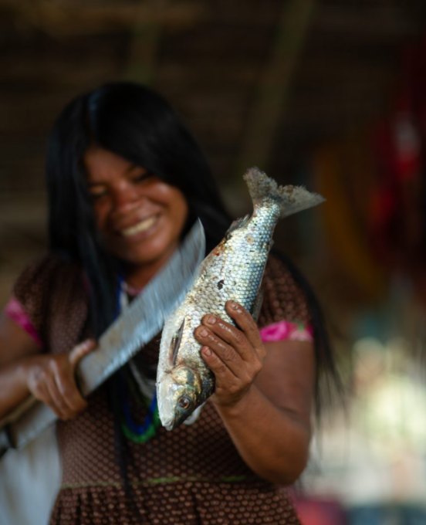
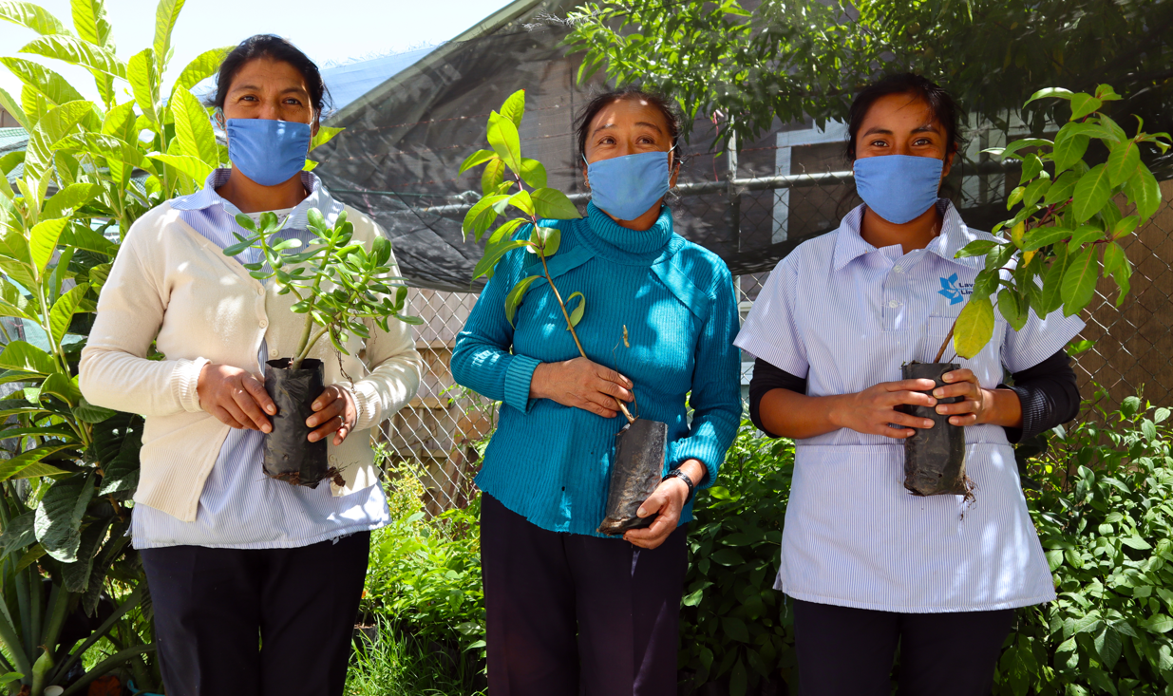
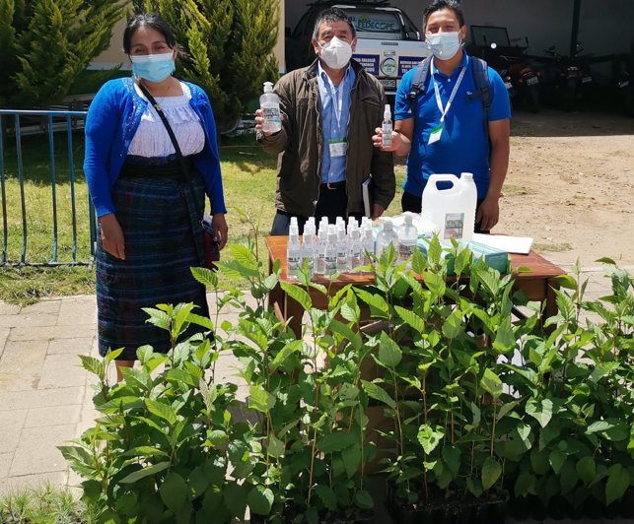
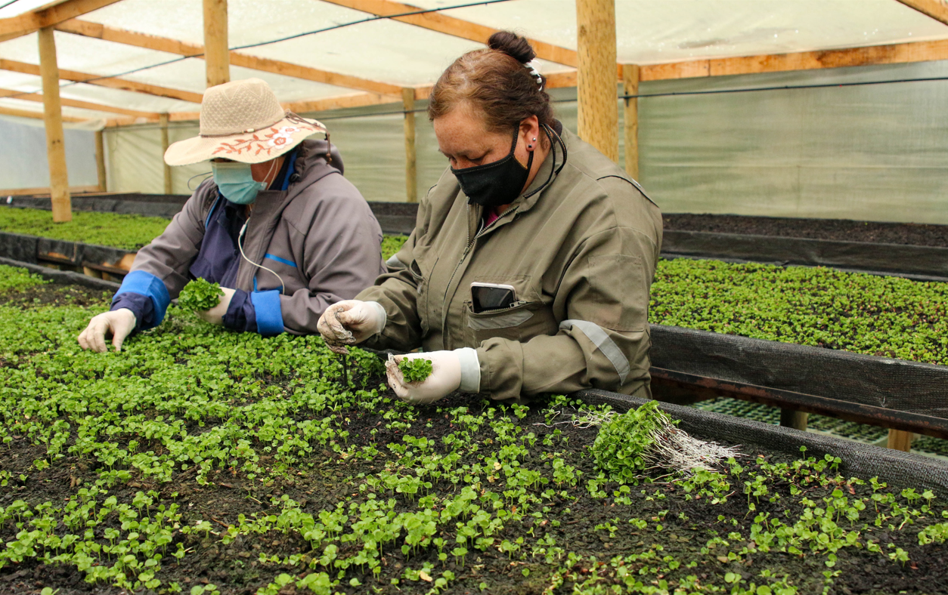
FP019 Ecuador
FP022 Morocco
FP111 Honduras
FP034 Uganda
FP117 Lao PDR
FP001 Peru
SAP023 Mexico
GCF Ecosystem and Forest Projects under implementation
Restoration
Conservation
Sustainable management
FP087 Guatemala
FP120 Chile

Slide 7
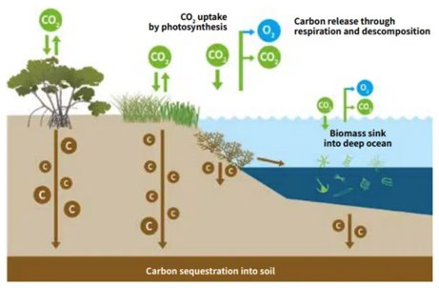
The potential of Blue carbon
Blue carbon ecosystems (seagrass meadows, tidal marshes and mangrove forests):
Sequester carbon 10 times faster than mature tropical forests
Store 3 to 5 times more carbon than tropical forests
Co-benefits are considerable for biodiversity, coastal adaptation, livelihoods & food security. They can help drive price of carbon up
Source: Coastal blue carbon and Article 6. IUCN, 2018

Slide 8
Voluntary carbon markets: Volumes and prices per sector
FLU & agriculture fetch higher prices thanks to co-benefits
Source: State of Voluntary Carbon Markets 2021

